Slide 1
INVESTIGATION OF INERTIAL SUPPORT LIMITS IN WIND TURBINES AND THE EFFECTS ON THE POWER SYSTEM STABILITY
Erencan DUYMAZ
Supervisor: Assist. Prof. Dr. Ozan KEYSAN
Thesis Defence
For
The Degree of Master of Science
Friday, January 18th, 2019

Slide 2
Agenda
Problem Definition: Renewable Energy Problems
Grid Inertia, Frequency and Inertial Support
Wind Turbine Modelling
Fast Inertial Support
Synthetic Inertia Support
Economical Perspective

Slide 3
Renewable Energy Problems

Slide 4
Renewable Energy Problems

Slide 5
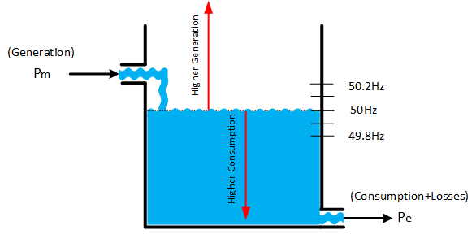
Frequency

Slide 6
Wind Turbine Modelling

Slide 7
Wind Turbine Modelling

Slide 8
Fast Inertia Support

Slide 9
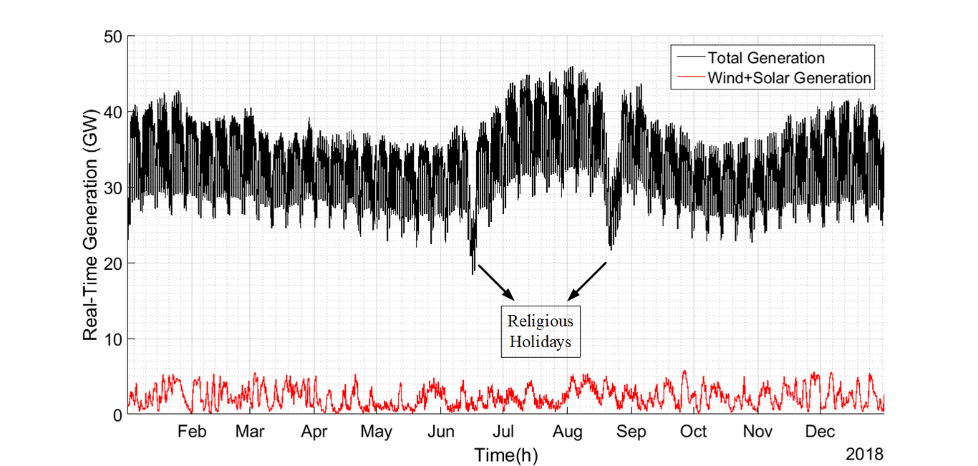
Synthetic Inertia

Slide 10
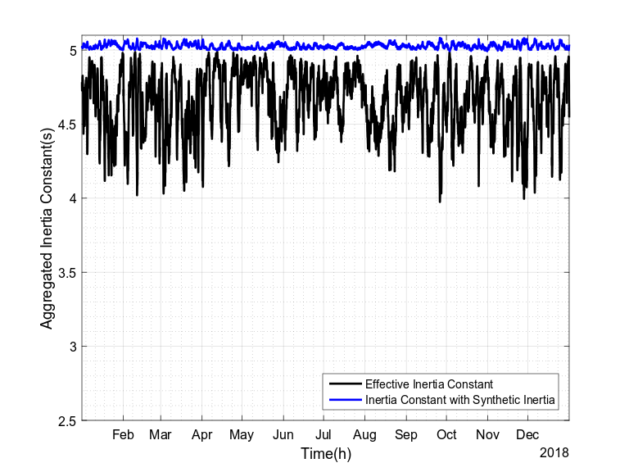
Synthetic Inertia

Slide 11
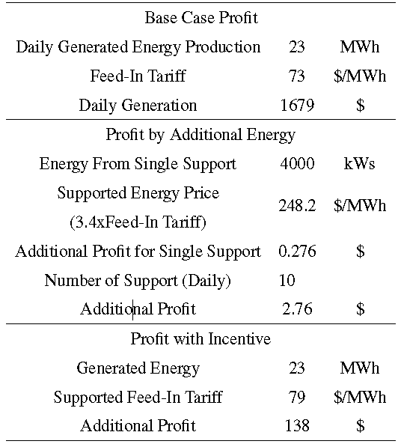
Economical Perspective

Slide 12
Economical Perspective
Net additional energy is zero! (There exists losses due to deviation from MPPT, inside the gearbox, converter etc.)
Let us only pay for increased period (neglect the decrease):
A single support profit: $0.276 vs Daily Generation=$1679
Not possible with additional energy!
Inertial support might be paid with incentives.
Incentives will end at the end of 2020 for the new generation renewable energy systems. A new incentive might be inertial support from renewable energy systems!

Slide 13
References

